Slide 1
Accelerators
Group 2
CS 527 Parallel Computer Architecture
Architecture Study
Members :
Abhishek Kumar 180101003
Aniraj Kumar 180101007
Munindra Naik 180101045
Ritik Mandloi 180101066

Slide 2
About
Accelerators are a piece of specialized hardware circuitry that implements various functions in order to perform a set of operations with higher performance or greater energy efficiency than a general purpose microprocessor.
The use of accelerators by software to speed up various operations is called hardware acceleration.
Accelerators are used to significantly improve the performance of certain workloads.They improve the execution of a specific algorithm by allowing greater concurrency, having specific datapaths for their temporary variables and reducing the overhead of instruction control in the fetch-decode-execute cycle.

Slide 3
Design Goals
Low energy consumption
Increased Parallelism
Better real-time performance
Better utilization of area
Speedup

Slide 4
How accelerators are used ?
Accelerators are generally embedded on the chip near the processor
They are attached to the base processor via system bus such as PCI Express or HyperTransport
They appear as a device on the bus which receive instructions from the base processor
They are generally invoked to perform certain computation efficiently which are designed for

Slide 5
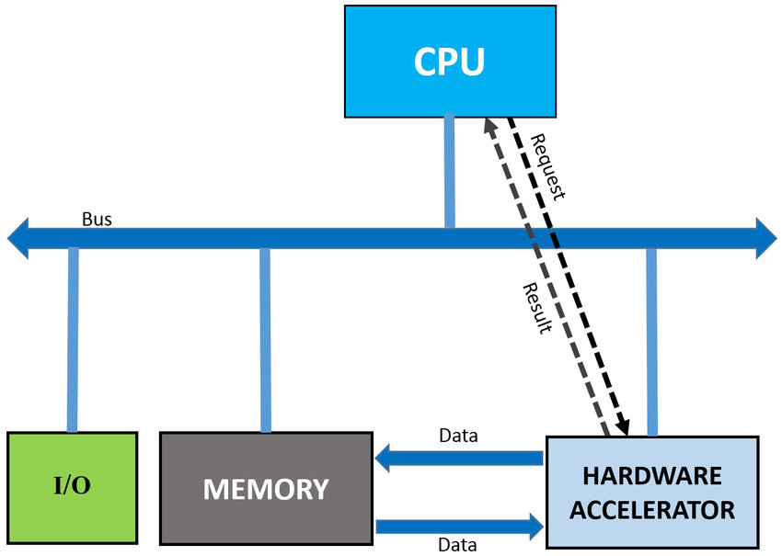
General Diagram of Accelerator Architecture

Slide 6
How accelerators increase performance and gain efficiency ?
Accelerators mainly exploit four main techniques for performance and efficiency gains:
Data Specialization - Specialized operations on domain specific data types can do in one cycle what may take tens of cycles on general purpose processor. Specialized logic to perform an inner-loop function gains in both performance and efficiency
Parallelism - High degree of parallelism, often exploited at lower levels, provide gain in performance. To be effective, the parallel units must exploit locality and make very few global memory references or their performance will be memory bound

Slide 7
Local and Optimized Memory - By storing key data structures in many small, local memories, very high memory bandwidth can be achieved with low cost and energy. Access patterns to global memory are optimized to achieve the greatest possible memory bandwidth. Memory accesses are load-balanced across memory channels and carefully scheduled to maximize memory utilization.
Reduced overhead - Specialized hardware eliminates or reduces the overhead of program interpretation.

Slide 8
Technology Used in Implementation
Accelerators are structural units which is connected to the host processor of the system which helps it to perform tasks more efficiently and faster, which can be implemented by following ways -
Specialized Processors
FPGA (Field Programmable Gate Array)
ASIC (Application-Specific Integrated Circuits)

Slide 9
Specialized Processor
It is a separate processor that uses hardware optimized for the intended types or type of logic. They are also known as Coprocessor which gets instructions from host processor to execute.
A popular example is GPU, it contains a set of processors designed for certain tasks such as shading and ray tracing.
Originally GPU’s were designed the motion of image, GPU’s are now used for calculations involving massive amounts of data, accelerating portions of an application.

Slide 10
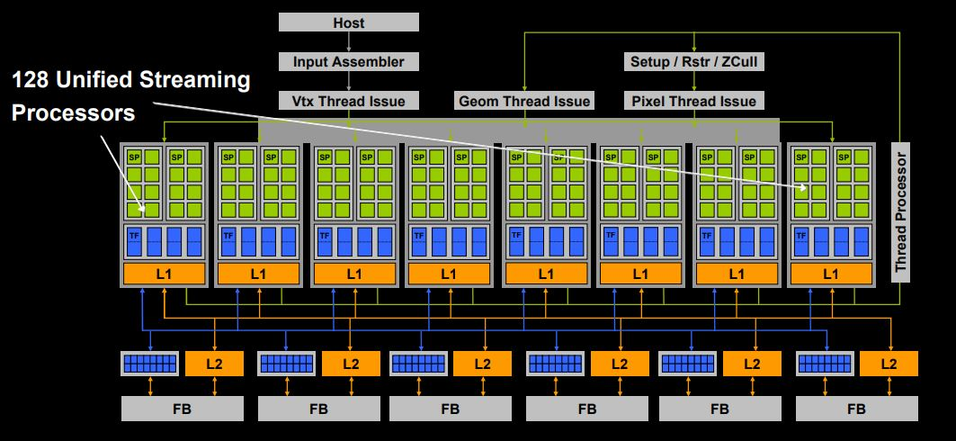
GPU architecture of Nvidia GeForce 8800 GTX containing 128 processors

Slide 11
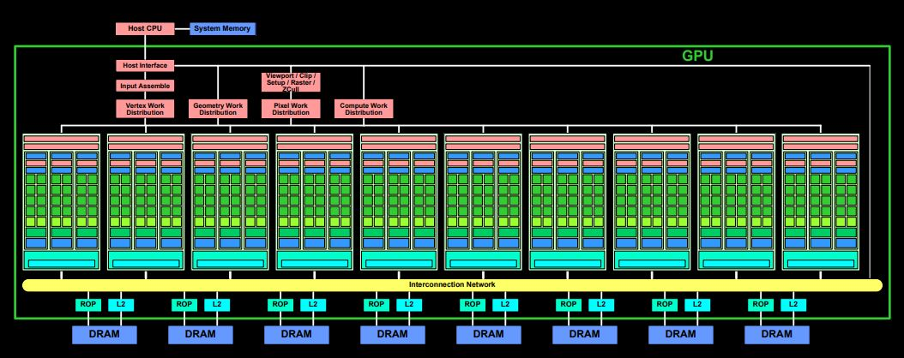
Architecture of GTX280 containing 240 processors

Slide 12
FPGA (Field Programmable Gate Array)
It is a processor that is designed to be able to be configured by the user after manufacturing. They can be programmed to be suited for a range of different logic functions, depending on the task.
They are re-programmable which makes them popular for development for ASIC processors. They can also be considered as integrated blank circuits, with great capacity for parallelism, which can be adapted or modified to solve complicated tasks in an efficient way.

Slide 13
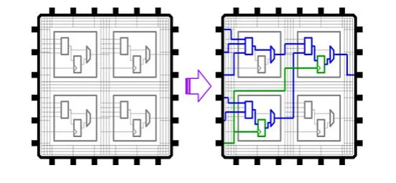
FPGA are made up of logical blocks and a powerful interconnection matrix. They can be considered integrated blank circuits, with great capacity for parallelism, which can be adapted to solve tasks in a preformative way.

Slide 14
ASIC (Application Specific Integrated Circuits)
These processors are optimized specifically for running a single task. With ASICs there is never any intent for the processor to be used for anything other than exactly what they are designed for.
They employ strategies such as optimised memory use and the use of lower precision arithmetic to accelerate calculation and increase the throughput of computation.
They are generally used over workstations which have a specific computation in their operation, which in case will be used frequently by the system.

Slide 15
Hardware Acceleration units by Application
Application | Hardware Accelerator | Acronym
Computer Graphics General Purpose tasks Nvidia graphics cards Ray tracing | Graphics Processing Unit General Purpose computing on GPU CUDA architecture Ray-tracing hardware | GPU GPGPU CUDA RTX
Digital Signal Processing | Digital Signal Processor | DSP
Sound Processing | Sound Card and Sound card mixer | N/A
Artificial Intelligence Machine Learning/Computer Vision Neural Networks | AI accelerator Vision Processing Unit Physical Neural Network | N/A VPU PNN
Multilinear Algebra | Tensor Processing Unit | TPU

Slide 16
Accelerator used in Real-life

Slide 17
Xeon Phi
Xeon Phi is a series of multicore processors or coprocessor designed and made by Intel.

Slide 18
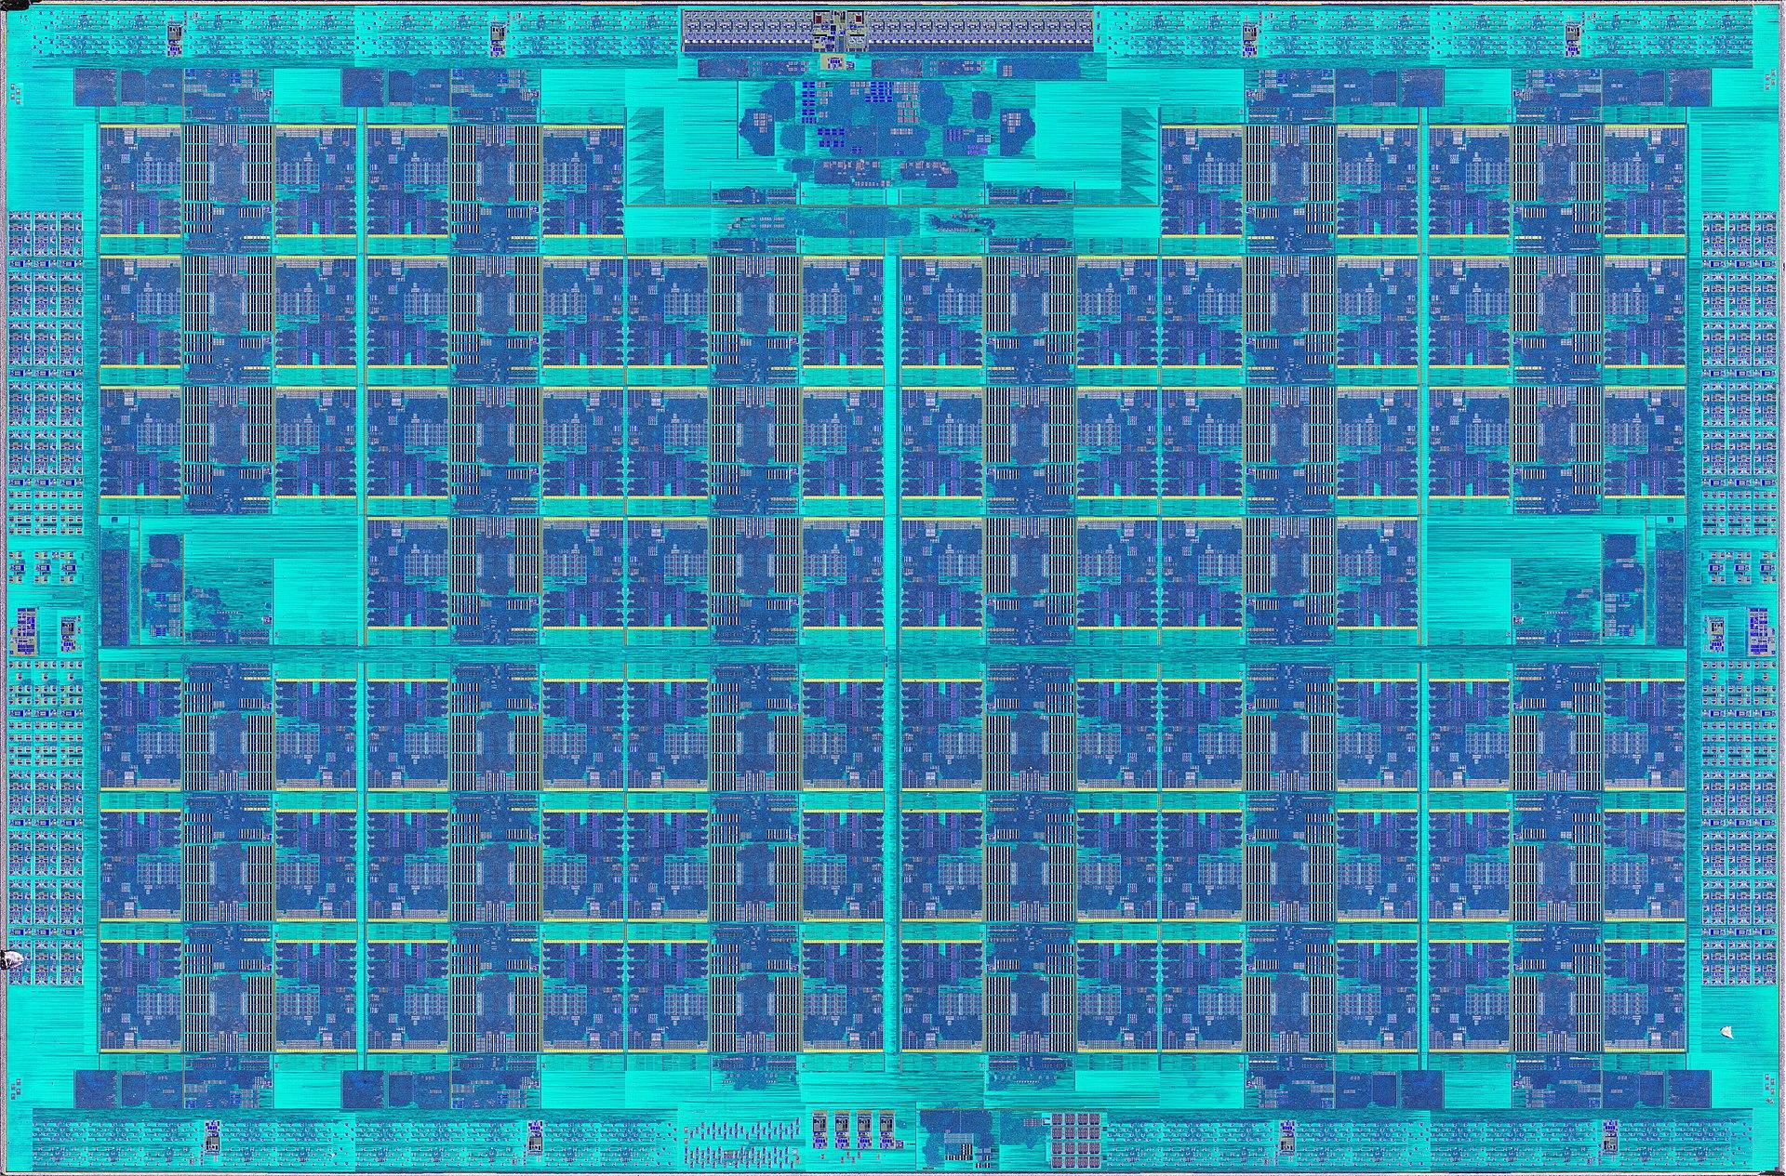
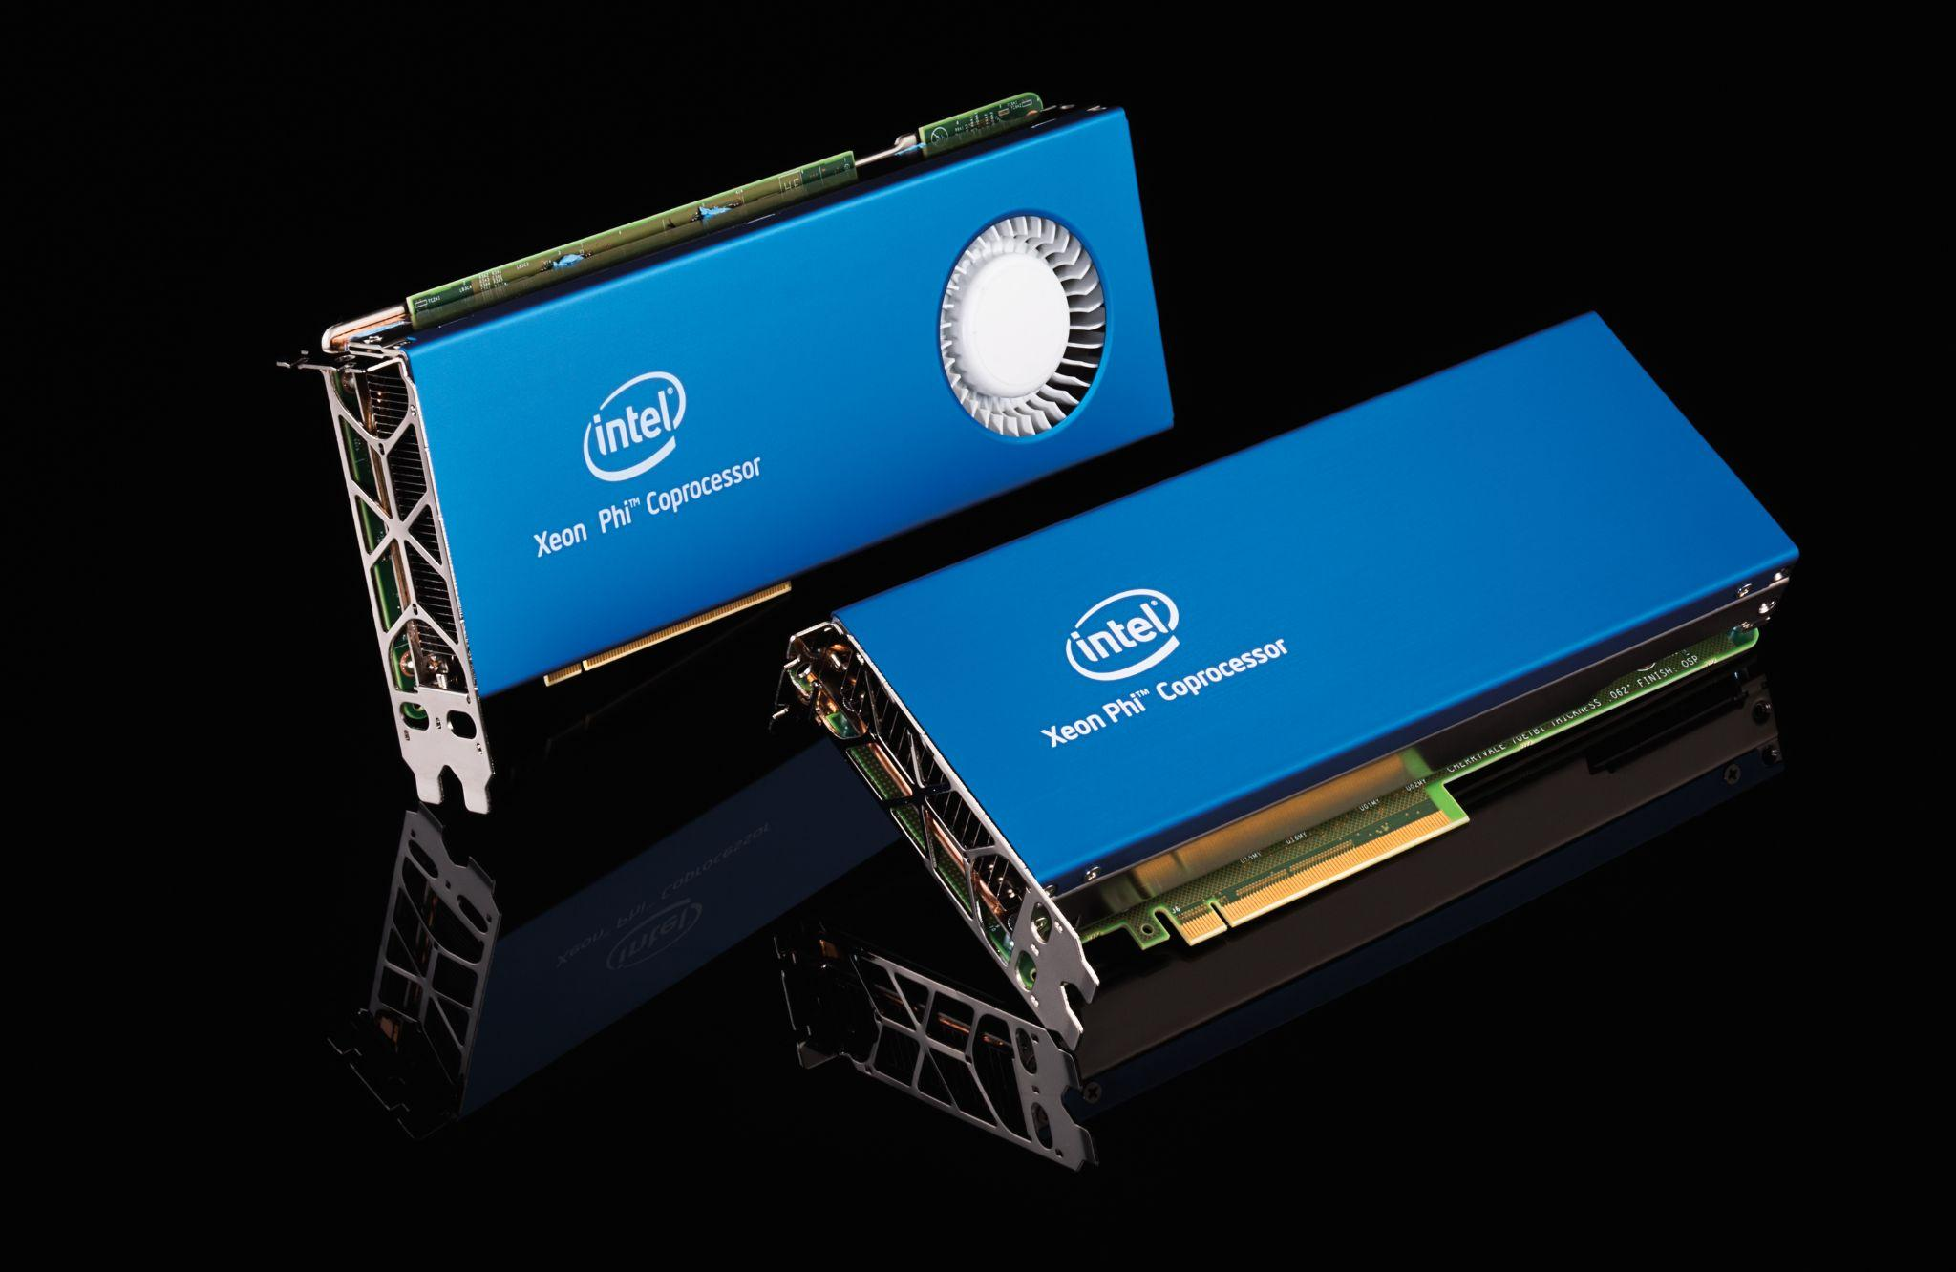
Image of Xeon phi coprocessor

Slide 19
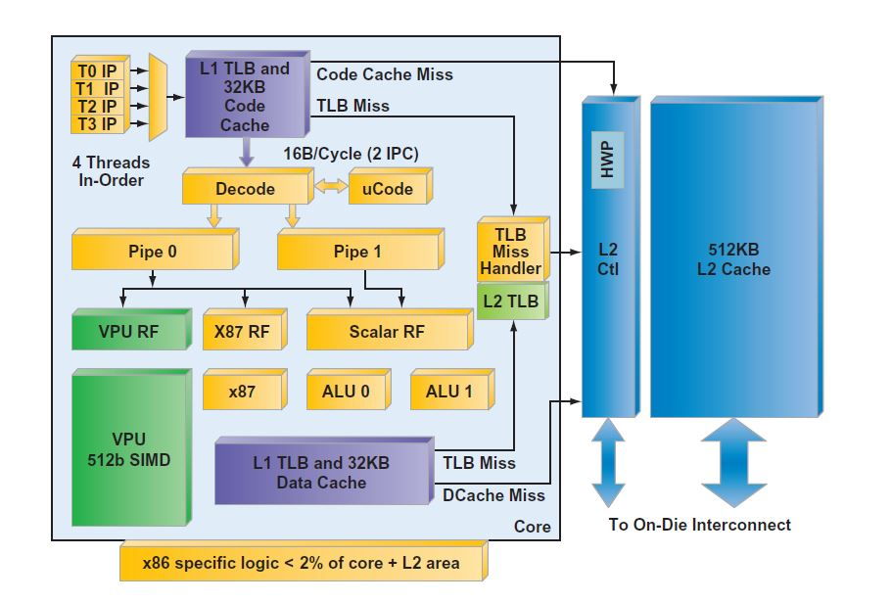
Architecture of Single Intel Xeon Phi Coprocessor core

Slide 20
About Xeon Phi
Xeon Phi is a series of x86 manycore processors which was intended for use in supercomputers, servers and high-end workstations.
Originally they were introduced as PCIe-based add-on cards but later development of Xeon Phi processor led them to be standalone processors rather than just as an add-in card.
Tianhe - 2 a supercomputer located in National Supercomputer Center in Guangzhou,China used Xeon Phi coprocessors along with Xeon Processors which was considered as the world’s fastest supercomputer in July 2013

Slide 21
Torrenza
AMD’s Torrenza was an initiative to create by opening access to the AMD64 Direct Connect Architecture to enhance acceleration and coprocessing.

Slide 22
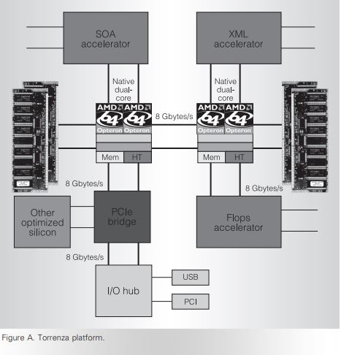
Image of Torrenza platform, illustrating customized designed accelerators for processing of Extensible Markup Language (XML) documents or for service-oriented architecture (SOA) applications can be tightly coupled with Opteron processors

Slide 23
About Torrenza
It was an initiative to improve support for integration based on AMD Opteron microprocessors.
The primary focus is on the integration of coprocessor devices directly connected to Opteron processors’ HyperTransport links and other coprocessors connected via PCI Express.
It included improving technical and technology support for third party developers of co processing devices, reducing the cost of implementing HyperTransport interfaces on these devices, and improving the performance of the integrated system.

Slide 24
References
AMD Torrenza
Accelerator Architecture
Nvidia GPU architecture
Domain - Specific Hardware accelerators

